Slide 1

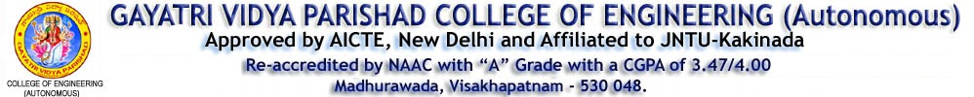
EARLY STAGE DIABETES PREDICTION USING MACHINE LEARNING TECHNIQUES & DJANGO
DEPARTMENT OF COMPUTER SCIENCE AND ENGINEERING
Presented by:
Gollapalli Bhavya Moulika (17131A0562)
Jahnavi Sanjana Patnala (17131A0577)
Kesavadas Sri Sai Tharun (17131A0599)
Kurli Vineetha (17131A05B7)
Guided by:
Dr.G.Satya Keerthi
M.Tech.,Ph.D
Assistant Professor

Slide 2
OUTLINE:
Abstract
Introduction
Existing system
Drawbacks of the Existing system
Proposed System
Block Diagram of Proposed system
Brief Introduction about Block Diagram
Software and Hardware requirements
Implementation of work
Results
Sample test cases
Conclusion
References

Slide 3
ABSTRACT
Diabetes Mellitus is a condition that impairs the body’s ability to process blood glucose and is considered as one of the most lethal diseases in the world.
The aim of the project is to develop a system, which might predict the diabetic risk level of a patient, based on certain diagnostic measurements. We will be performing exploratory Data analysis on the data collected and then use various machine learning algorithms to train the model.
After training and testing the model with various machine learning algorithms, We will be creating a web page, with the help of “Django” framework, that takes input form the user and the predict whether a person is diabetic or not.

Slide 4
INTRODUCTION
Diabetes is a condition, when our body isn’t able to take up Sugar (Glucose) into it’s cells and use it for energy, which results in build up of extra sugar.
There are 2 types of Diabetes:
type 1: It is usually diagnosed in children and young adults. People with type-1 diabetes
needs to take insulin every day.
type 2: It occurs usually in middle aged to older people. In this type, the body doesn’t
make enough insulin and is called insulin-resistant diabetes.
The dataset which we have used in this project contains the signs and symptoms data of newly diabetic or would be diabetic patients. This dataset is originally from the National Institute of Diabetes and Digestive and Kidney Diseases.

Slide 5
The following features have been provided to help us predict whether a person is diabetic or not:
Pregnancies: Number of times pregnant
Glucose: Plasma glucose concentration over 2 hours in an oral glucose tolerance test
BloodPressure: Diastolic blood pressure (mm Hg)
SkinThickness: Triceps skin fold thickness (mm)
Insulin: 2-Hour serum insulin (mu U/ml)
BMI: Body mass index (weight in kg/(height in m)2)
DiabetesPedigreeFunction: Diabetes pedigree function (a function which scores likelihood of diabetes based on family history)
Age: Age (years)
Outcome: Class variable (0 if non-diabetic, 1 if diabetic)

Slide 6

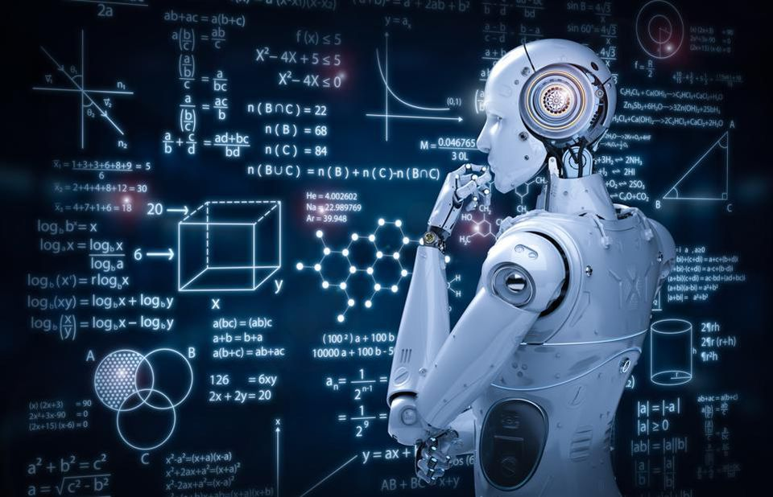

Healthcare industries generates large volumes of data, which consists of it’s patient’s records and it is necessary to Collect, Store and Process this data, to discover knowledge from it and utilize it to take significant decisions.
TECH STACK used:
Data Science
Machine Learning
Django

Slide 7
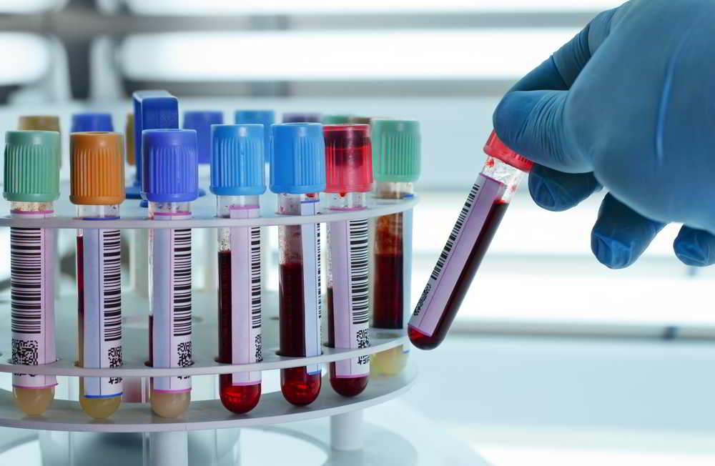
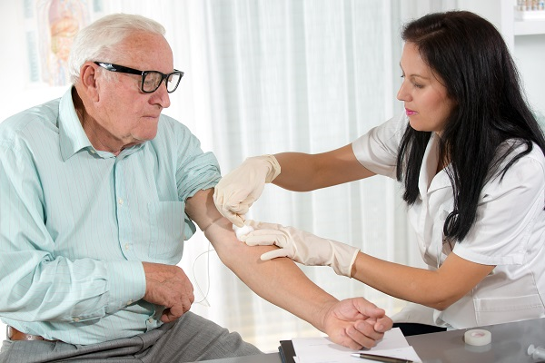
LITERATURE SURVEY(Existing system)
Current practice in hospitals is to collect required information for diabetes diagnosis through various tests, and appropriate treatment is provided based on diagnosis.
Various traditional methods, based on physical and chemical tests, are available for diagnosing the diabetes.
The existing instances of datasets consists of only two groups i.e, blood tests and urine tests. Implementation is done by WEKA tool, to classify the data.

Slide 8
DRAWBACKS OF EXISTING SYSTEM
In existing method, the classification and prediction accuracy are not so high and is a time taking process, as it needs a heavy investment of time, to get the reports.
Early stage prediction cannot be possible, as it is a challenging task for medical practitioners
Classifying the data using WEKA tool can only be performed only on small datasets.

Slide 9
PROPOSED SYSTEM
Machine learning is considered to be a dire need of today’s situation in order to eliminate human efforts by supporting automation with minimum flaws.
In this project, we will be proposing a predictive model, for diabetes detection, using machine learning algorithms and for better classification of diabetes we included few external factors.
Predictive Analysis (Supervised learning), incorporates a variety of machine learning algorithms, data mining techniques and statistical methods that uses current and past data to find knowledge and predict future events.

Slide 10
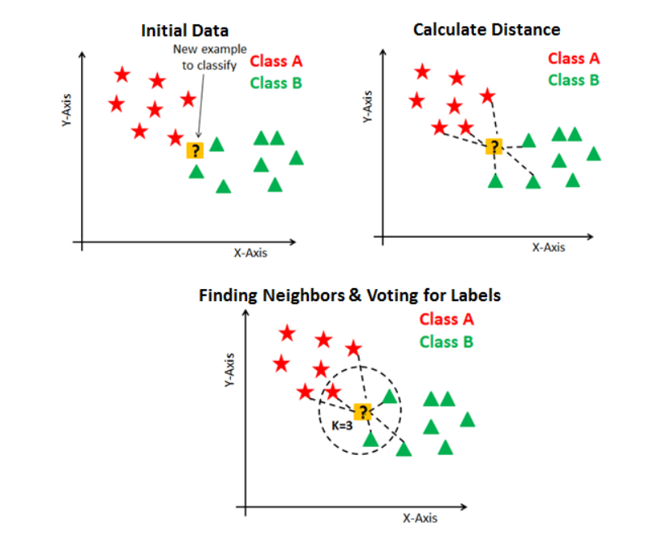
K-NEAREST NEIGHBORS CLASSIFIER
KNN has the following basic steps:
1) Calculate distance
2) Find closest neighbors
3) Vote for labels
Fig. KNN Classifier

Slide 11
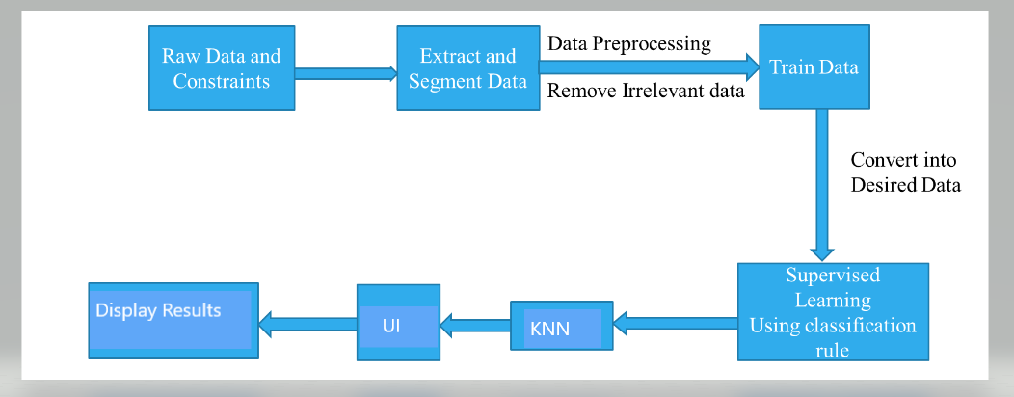
SYSTEM DESIGN (Block Diagram)
PROCESS FLOW
Fig. Process Flow Diagram

Slide 12
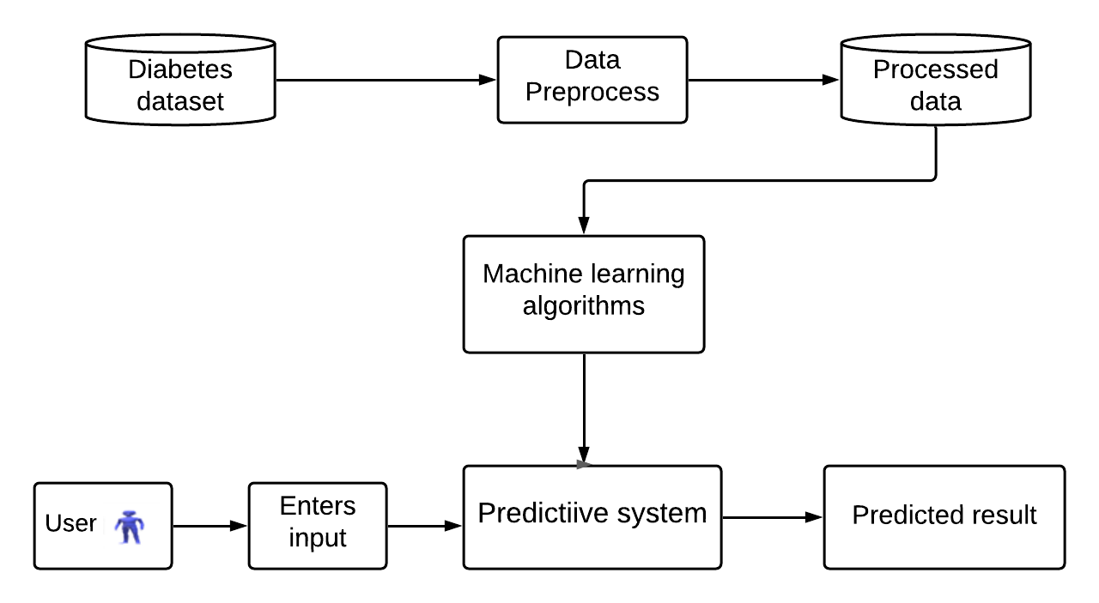
ARCHITECTURE DIAGRAM
Fig. Architecture Flow

Slide 13
BRIEF INTRODUCTION OF THE BLOCK DIAGRAM
The dataset needs to be preprocessed, by removing all the irrelevant data and then, the preprocessed data is used to train the model, using KNN Classifier and thus making a predictive system, for predicting the diabetic condition.
Then, we have developed an User Interface (UI), for a person to input the values based on his medical conditions and check whether he/she is diabetic or not.

Slide 14



SOFTWARE REQUIREMENTS
Operating System: Windows
Programming Language: Python
Notebook: Google Colab
Libraries and Framework :
Numpy
Pandas
Sklearn
Django
HARDWARE REQUIREMENTS
Processor: Intel/AMD processor
RAM: 4 GB
Disc Space: 100 GB

Slide 15
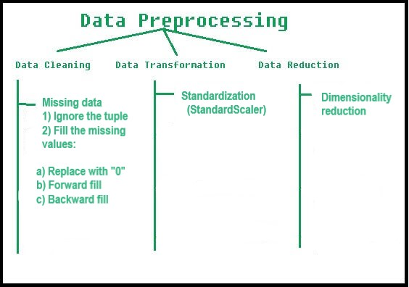
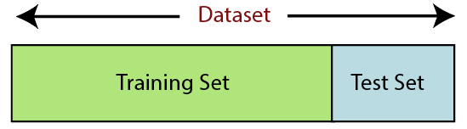
IMPLEMENTATION OF WORK
Stage-2: Train-Test split:
Stage-1: Data preprocessing

Slide 16
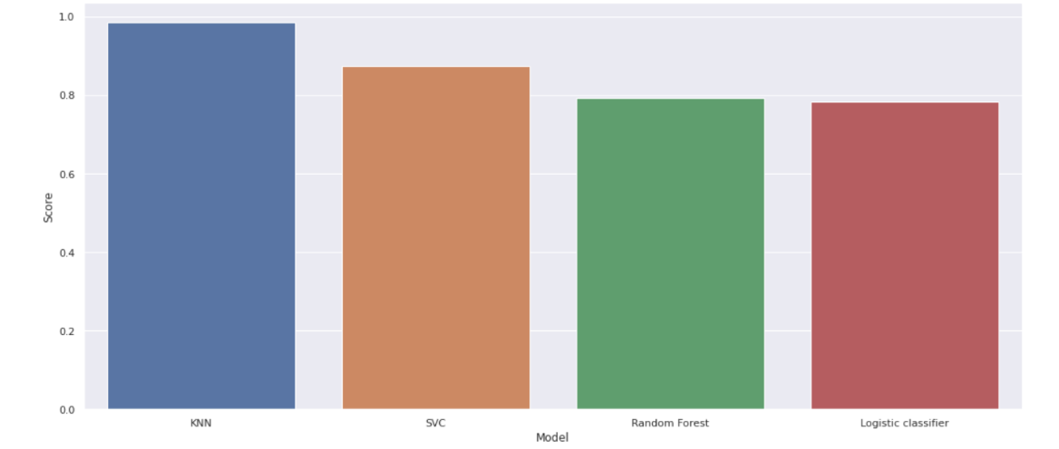
Stage-3: Building the machine learning model:
With the help of various machine learning algorithms like Logistic Regression, KNN, SVM, and Random forest classifiers., we have trained the model. At the end, based upon the accuracy, we used the KNN algorithm for classification and prediction of diabetes using trained data.
Stage-4: Creating an UI and Linking ML model with Django:
Now we have to link this model with Django, to create a user interface to take the inputs from the user and thus based on the predictive system which we have developed, it will predict whether a person is diabetic or not.

Slide 17
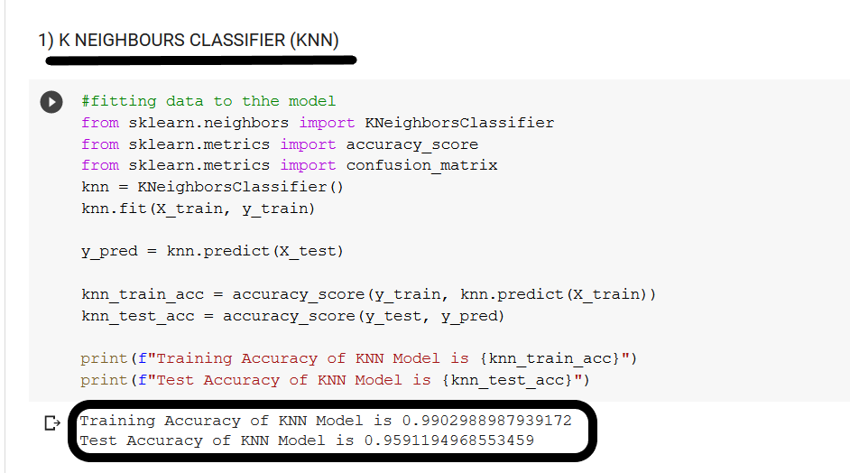
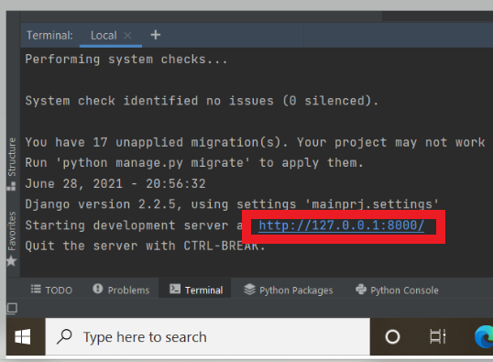
RESULTS
KNN Classifier Train-Test Accuracy:
Launching the Local Host, with Django:

Slide 18
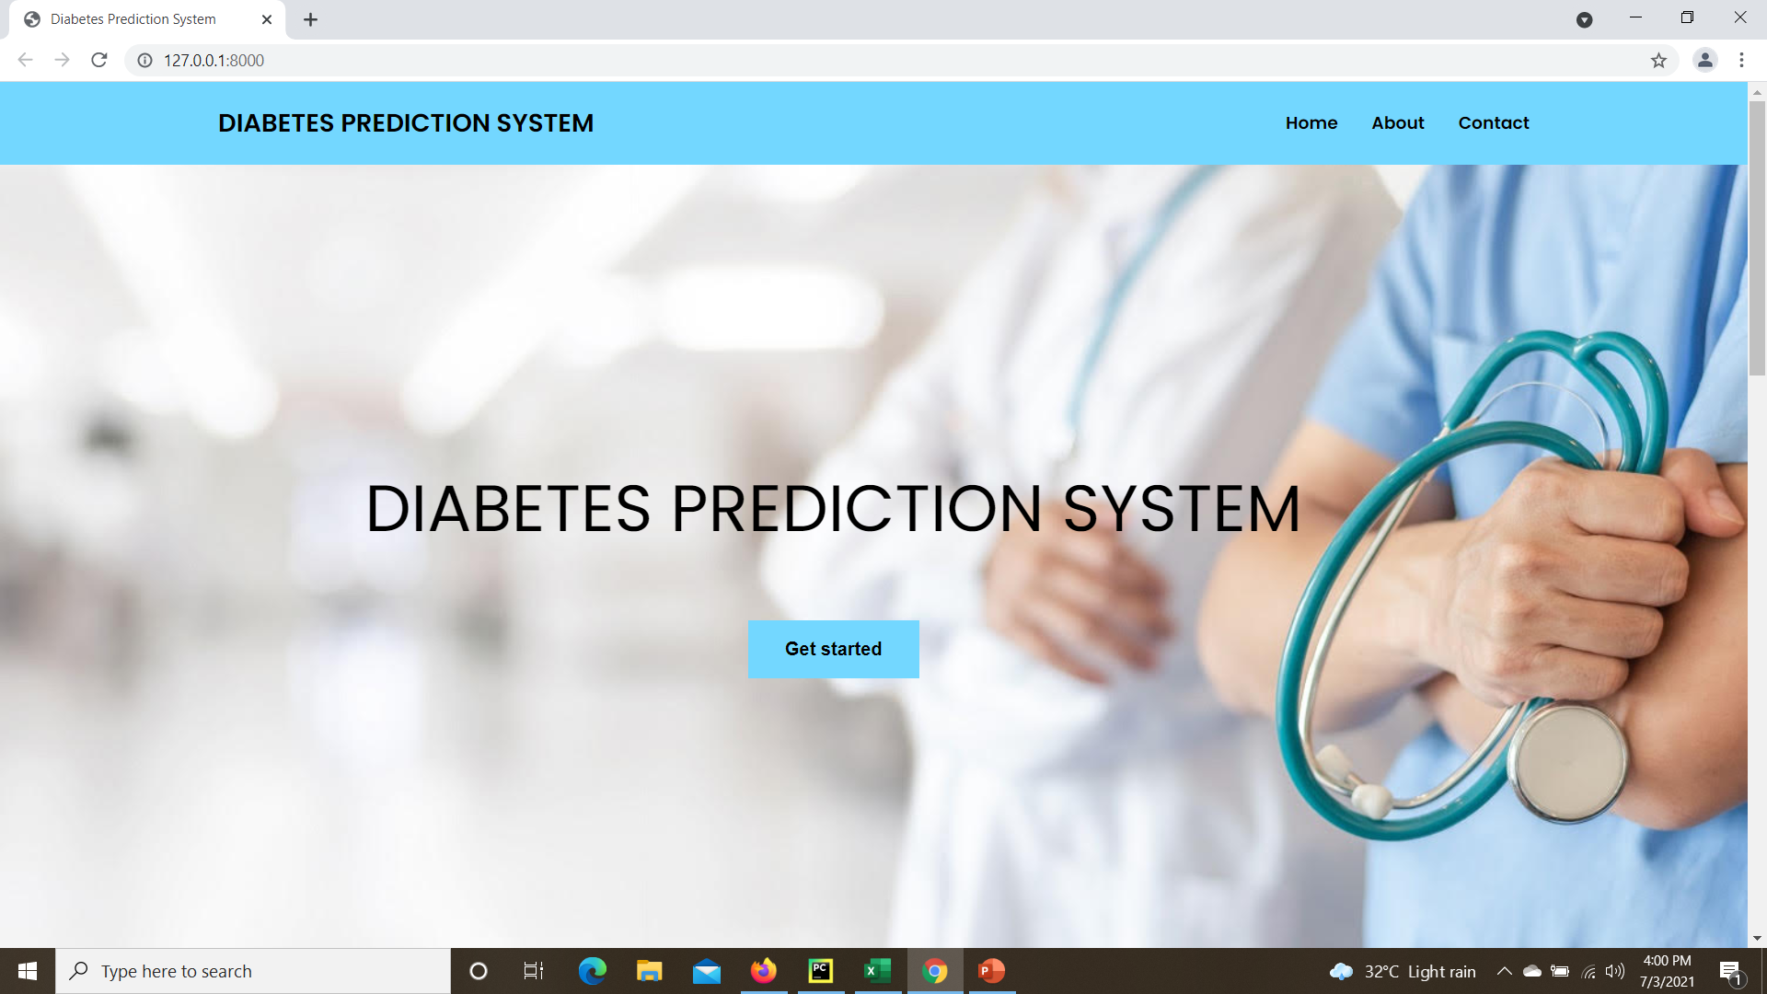
HOME_PAGE of Diabetes Prediction System:

Slide 19
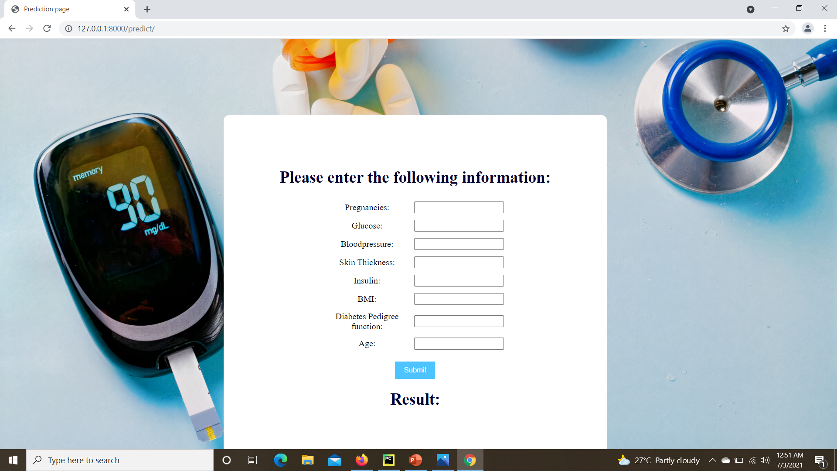
PREDICT_PAGE of Diabetes Prediction System:

Slide 20
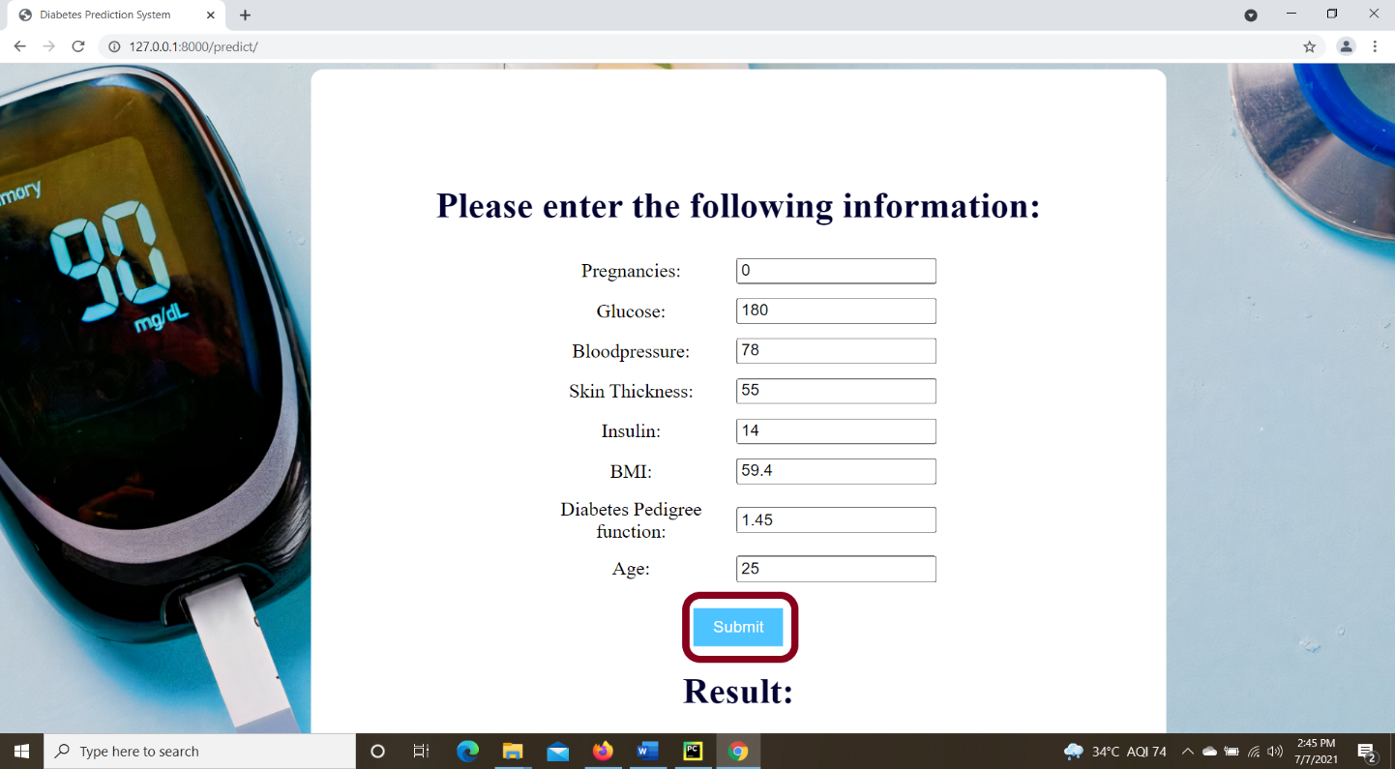
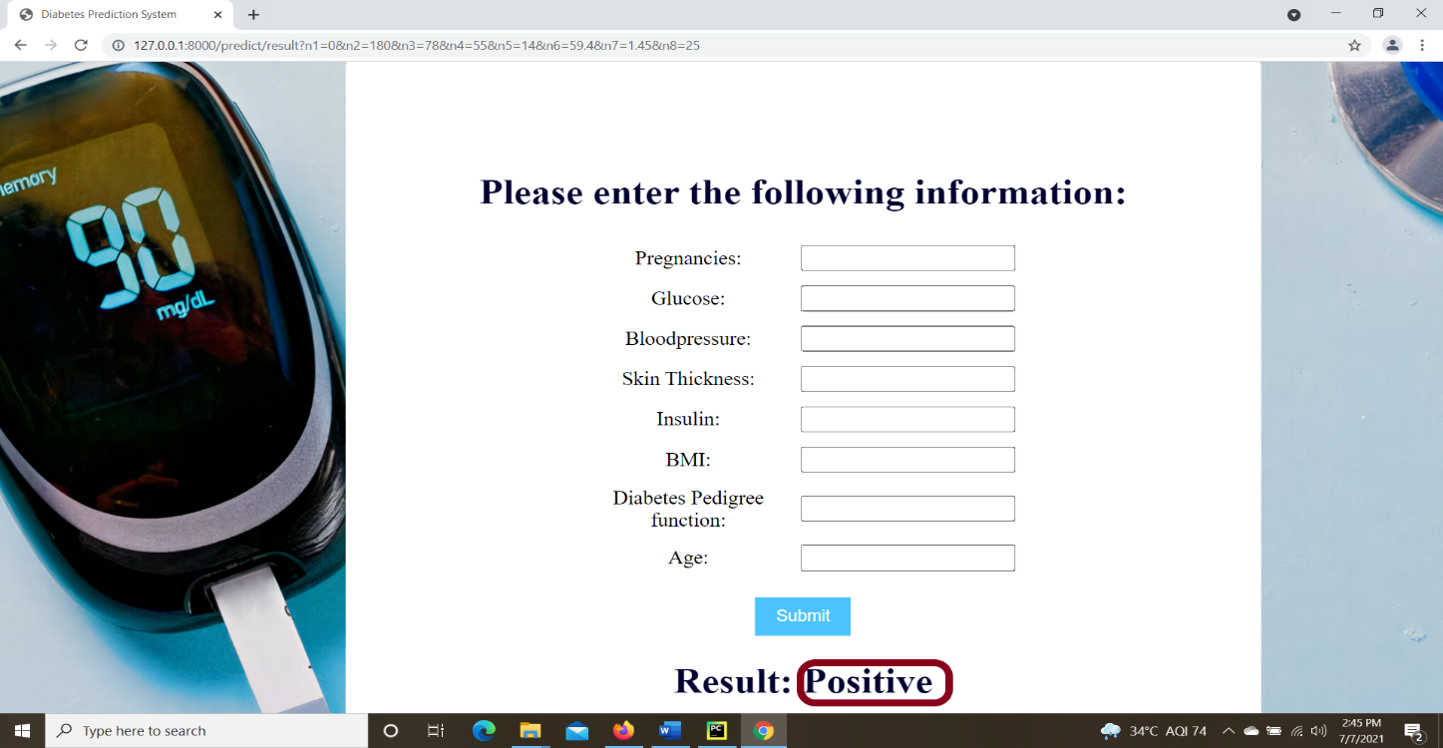
SAMPLE TEST CASES
Case 1: When person ‘A’ input the values, the system has to predict “POSITIVE”
INPUT
OUTPUT

Slide 21
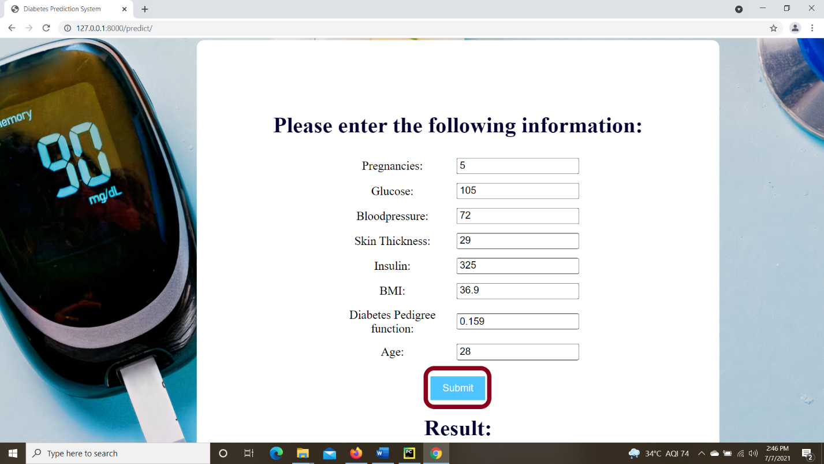
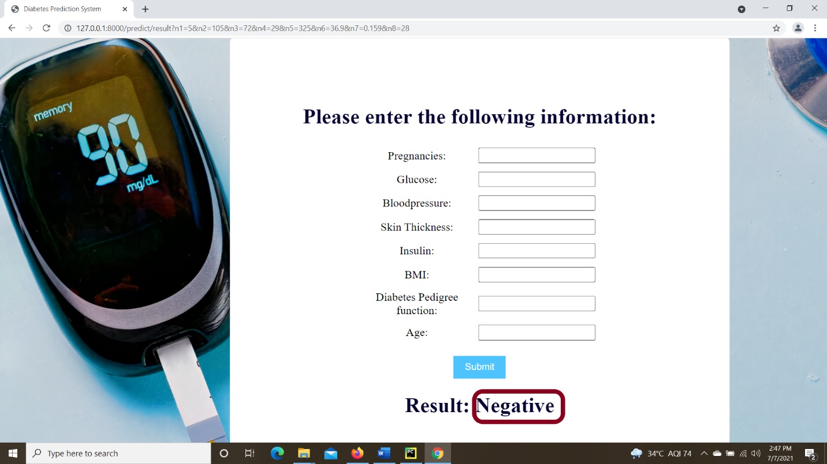
Case 2: When person ‘B’ input the values, the system has to predict “NEGATIVE”
INPUT
OUTPUT

Slide 22
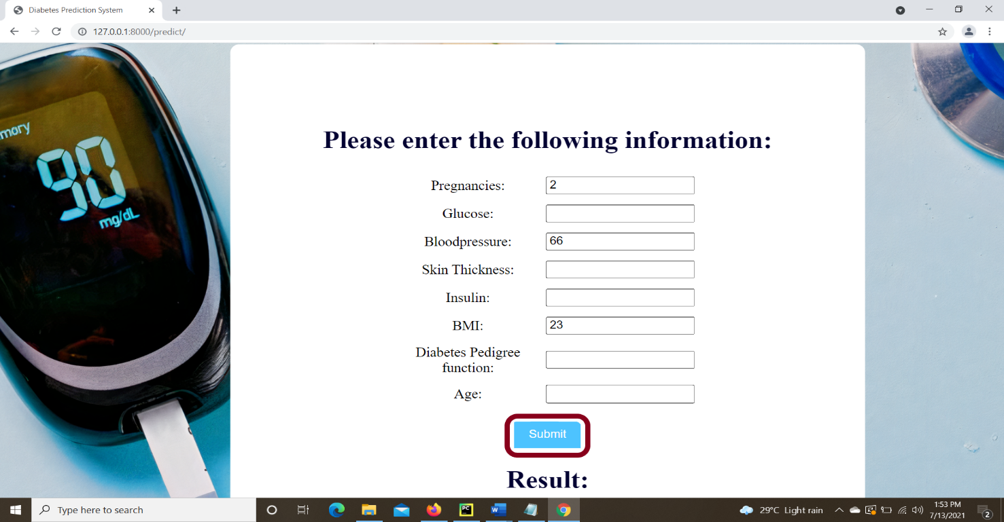
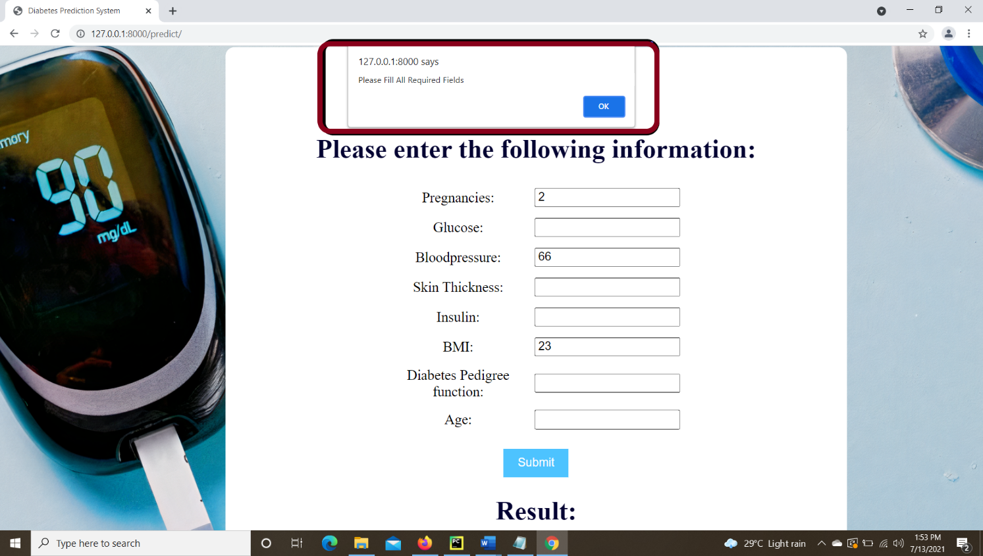
Case 3: When a person does not input all the values, the system has to display a prompt, as shown below:
INPUT
OUTPUT

Slide 23
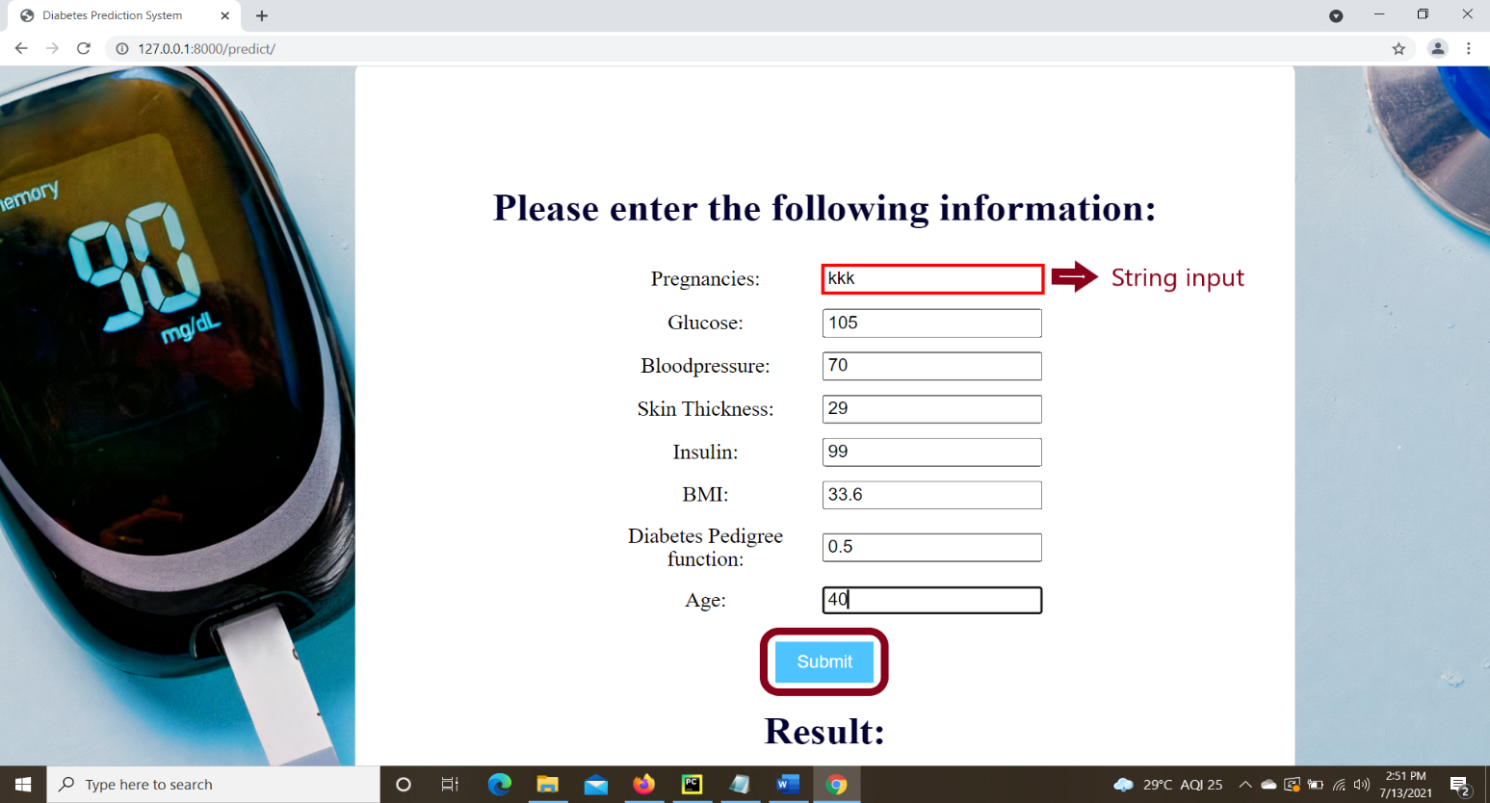
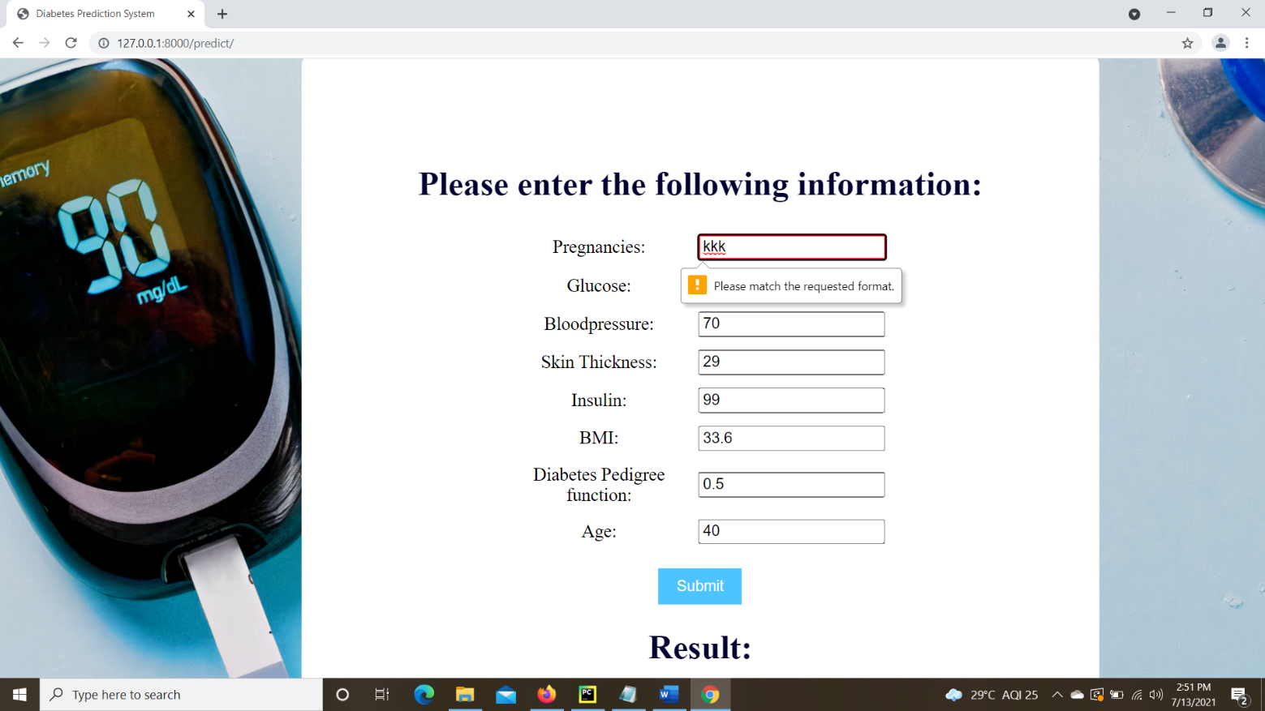
Case 4: When a person inputs a string / character, the system has to display a prompt, as shown below:
INPUT
OUTPUT

Slide 24
CONCLUSION
Diabetes can be controlled if it is predicted earlier. To achieve this goal ,we will do early prediction of Diabetes. and Early prediction of diabetes could lead to a better treatment of the disease and reduces the risk of hospitalization.
The system, which we have built is useful to physicians, to predict the diabetes in initial stages. So, that conventional treatments and solutions may be given to the patients.
We have successfully built a ML model and designed an UI, for Early stage Diabetes prediction.

Slide 25
REFERENCES
[1] Diabetes Database, URL : https://archive.ics.uci.edu/ml/machine-learning-databases/pima-indians-diabetes/
[2] Articles: https://towardsdatascience.com/machine-learning-an-introduction-23b84d51e6d0#3add
[3] Articles: https://docs.djangoproject.com/en/3.2/intro/tutorial01/
[4] “Classifying Medical Data to Predict the Likelihood of Disease” by Razan Paul, Abu Sayed Md. Latiful Hoque, IEEE 2010.
[5] “A Comprehensive Exploration to the Machine Learning Techniques for Diabetes Identification” Sidong Wei1, Xuejiao Zhao, Chunyan Miao Shanghai Jiao Tong University, China.
[6] “Performance Analysis of Machine Learning Techniques to Predict Diabetes Mellitus” Md Faisal Faruque, Asaduzzaman, Iqbal H. Sarker, IEEE 2019.

Slide 26


